Slide 1
ANALYSIS OF CLEVELAND DATASET
ACHAL SURESH, NIDA KAZI, SERGEY POSTOLSKY, YAOSONG YU

Slide 2
Data Exploration
Number of people with the heart disease: 137
Number of people without the heart disease: 159
Number of Men in the dataset: 112/200
Number of women in the dataset: 25/96
Age | 57 | 58 | 59 | 60
Proportion of cases | 61.53% | 83.33% | 61.53% | 100%

Slide 3
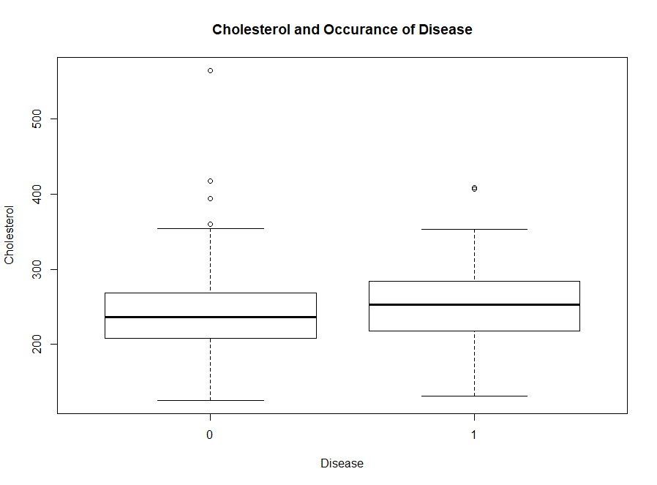
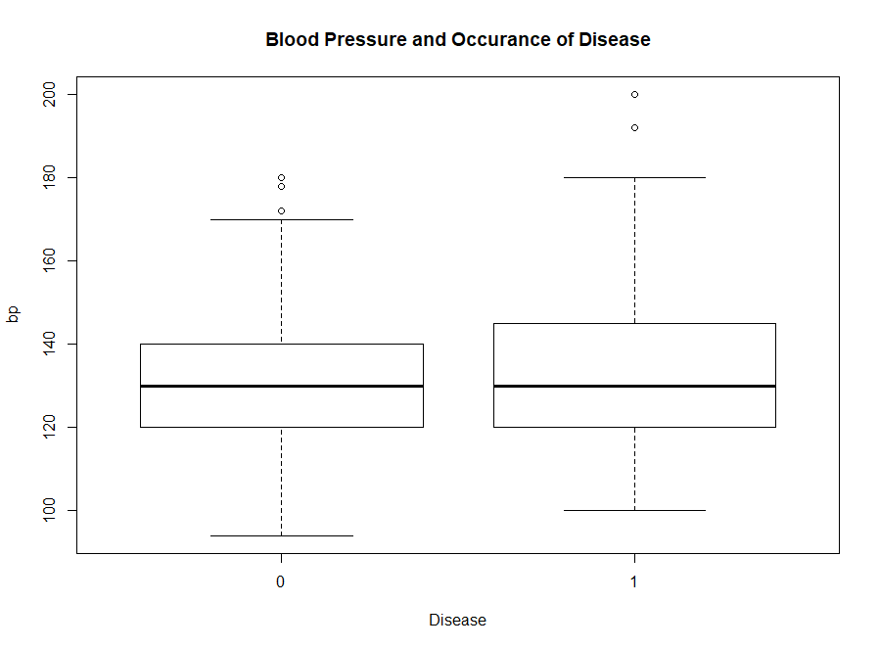
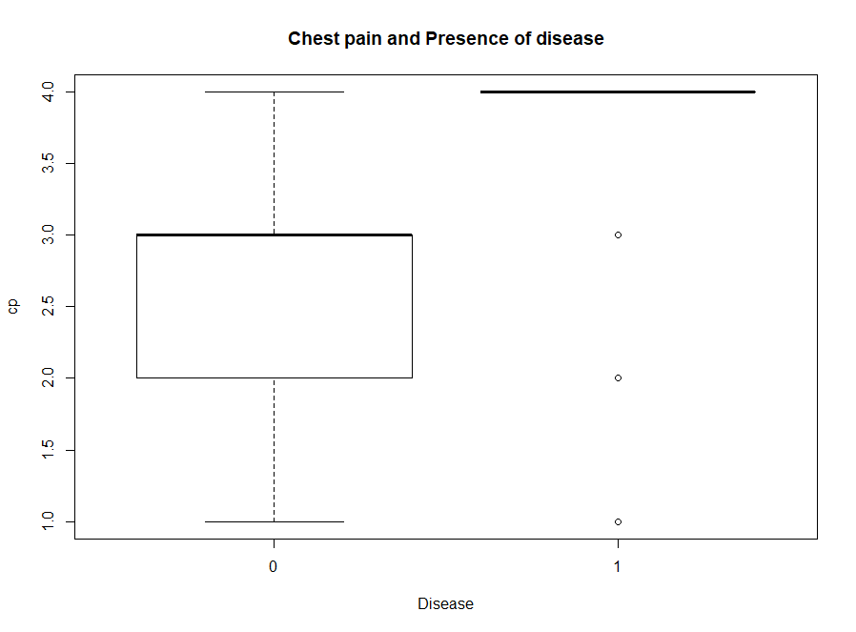

Slide 4
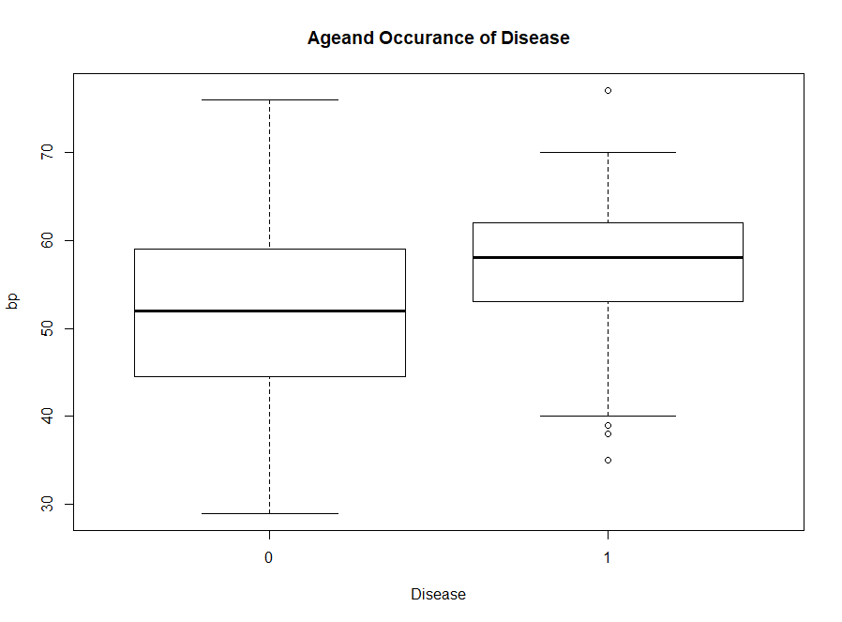
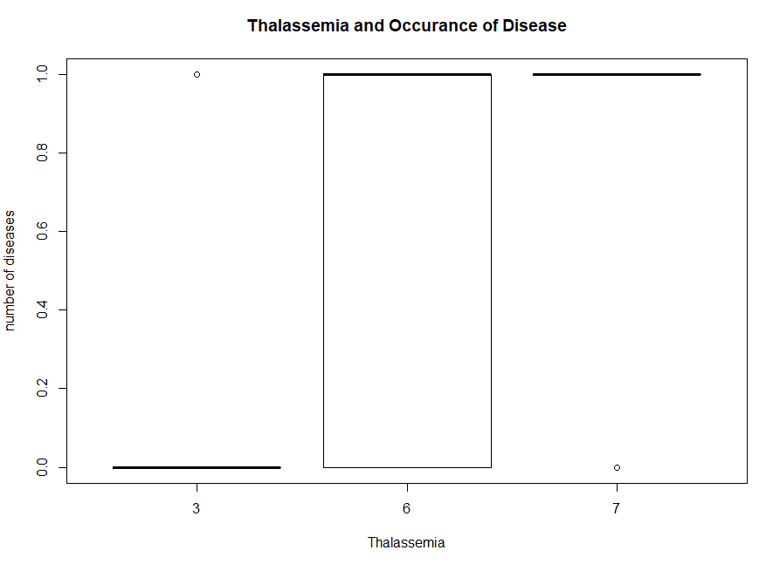

Slide 5
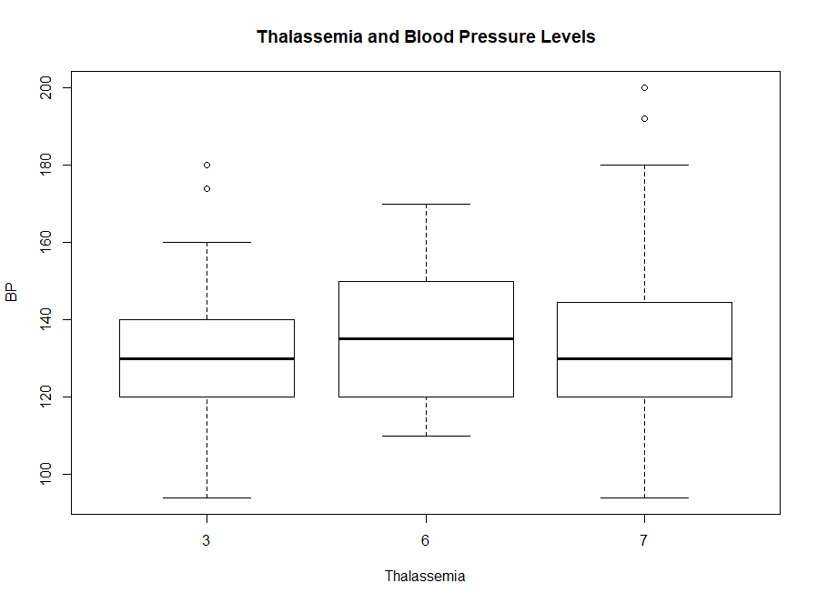
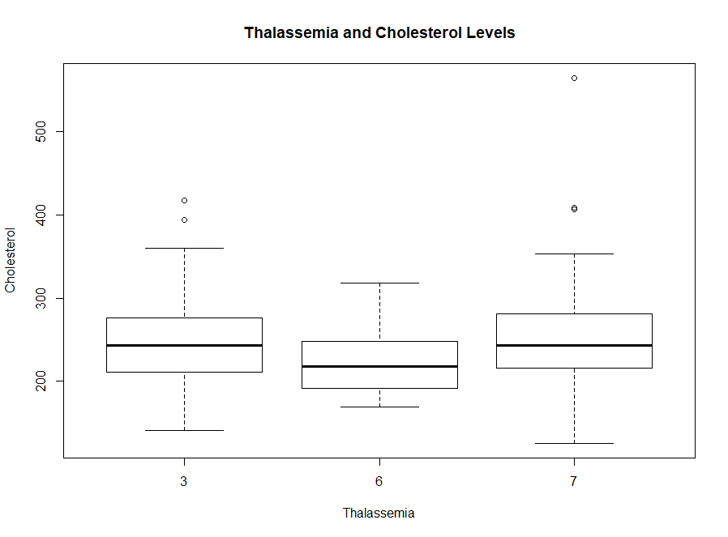

Slide 6
HYPOTHESIS
Hypothesis 1:
Different nums are affected by different parameters. Cholesterol, Age, Sex and Chest pain affect the NUM the most significantly.
Hypothesis 2:
Older men, with High Cholesterol and High BP are more prone to heart disease.
Hypothesis 3:
Trestbps and thalach can indicate if a patient has exang

Slide 7
METHOD - Hypothesis #1
Split “num” into 4 variables based on the level of severity of the heart disease: num1 - num4;
Split data on training (70%) and testing (30%);
Run Lasso on training data for each num to define min lambda;
Run logistic regression on training data to identify the most significant factors and their coefficients;
Assess the prediction accuracy using test data for predictions.

Slide 8
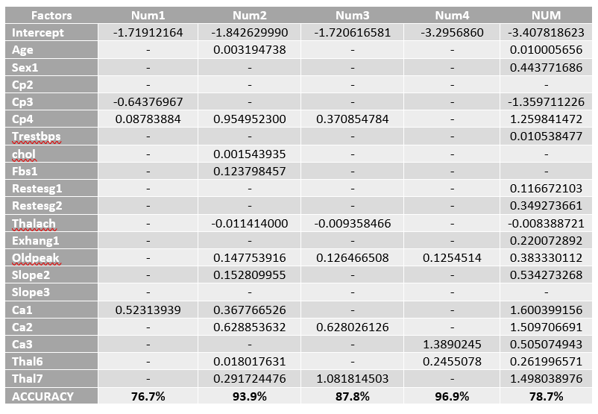
Results - Hypothesis #1

Slide 9
Interpretations - Hypothesis #1
Different factors influence heart disease prediction differently based on disease severity;
Surprisingly as it can be seen from the table, neither age nor sex nor cholesterol turned out to be significant factors in prediction of all heart diseases’ severity levels;
Additional observations and insights:
The bigger your maximum heart rate achieved (Thalach) the less likely you have a heart disease;
The following factors can be the best predictors of having heart disease: cp - chest pain (especially type 4), ca - number of major vessels (0-3) colored by fluoroscopy and thal – thalassemia (especially type 7).

Slide 10
METHOD - Hypothesis #2
Assign values of 0 & 1 on num
Perform LASSO to determine the best subset of the dataset with response variable as num.
Perform scaling on the predictors determined from LASSO
Using Hierarchical clustering with complete method on the dataset with predictors selected above

Slide 11
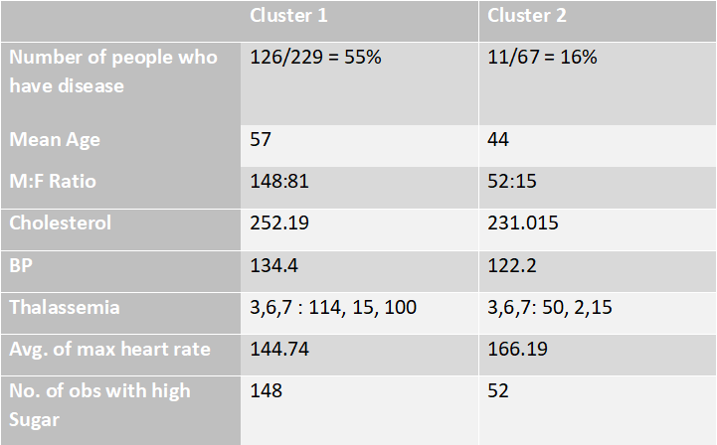
Results - Hypothesis #2

Slide 12
Interpretations - Hypothesis #2
There is a significant increase in number of heart diseases cases when the age of person increases from 44 to 57 and also probability of heart disease can be more for men.
The Cholesterol levels in the cluster with more heart diseases are significantly more apart
The Blood Pressure levels in both the clusters are appearing to be closer than expected.
Additional observations and insights:
The chances of having high blood sugar level can also increase with presence of heart disease.
People with reversible Thalassemia defect also have a higher chance of heart disease.

Slide 13
Methodology- Hypothesis #3
Resting blood pressure(trestbps) and maximum heart rate achieved (thalach) can indicate if a patient has exercise induced angina (exang).
Fit a logistic regression on trestbps and thalach regarding exang to test if the two predictors are of statistical significance.
Drop the predictor that’s not significant until the predictors are all significant

Slide 14
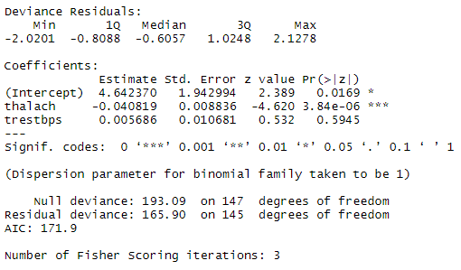
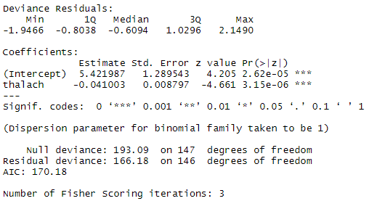
Results- Hypothesis #3

Slide 15
Interpretation - Hypothesis #3
Resting blood pressure(trestbps) is not an indicator of exang as tested in the logistic regression
maximum heart rate achieved (thalach) is a crucial indicator of exang.
Additional insights
Since heart rate is important in determining if a patient has exang, we may collect more data to test if heart rate is an important factor in indicating a patient’s overall health condition.

